Slide 1



Divine IT Limited
F Haque Tower
107 Bir Uttam C. R. Datta Road
Kalabagan
Dhaka - 1205
Phone: +880 2 9632207
Direct Sales: +880 173007101
Hotline: +880 1755661212
Email: sales@divineit.net
Web: www.divineit.net
Product Web: www.prismvat.net

Slide 2
Agenda
Company Profile
Industry Coverage
Features
Implementation Model
Security
Divine IT Client List
Demonstration

Slide 3
Company Profile

Slide 4
Divine IT Limited
Founded : 2005
Compliance : ISO 9001:2015, ISO 27001:2013, CMMI L3
Service : IT Consultancy, ERP Solutions and Web Application
Strength : Proficient and Energetic Team
Strategy : Innovation and Customer Retention
PSTP: Govt. Approved Private Software Technology Park
Infrastructure: 17,000 sq. ft. of office spaces consist of 4 offices
HR Capabilities: 120
Technology: Python, Java, PHP, Oracle, MySQL, PG, MS-SQL, Linux etc.

Slide 5




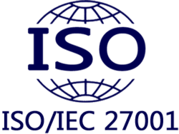







Awards
Certifications
Membership
National Productivity
Award 2016
APICTA 2017
1st Merit Award
in Retail ERP
ICT Award 2017
1st Place in Govt. ERP
ICT Award 2017
1st Place in Retail ERP

Slide 6
About VAT Management Software

Slide 7
Why VMS
National Board of Revenue (NBR), Bangladesh has been influenced to submit VAT returns digitally
Use of Software is mandatory for companies having an annual turnover of Taka 5 crore and above
The system will reduce the gap in between the organization and NBR regarding current calculation jargon
The application will further integrate with iVAS to submit the VAT report effectively without any error

Slide 8
About PrismVAT
Web based VAT Management Software
Recognized and Approved by National Board of Revenue (NBR), Bangladesh
Automatically calculates organizational VAT on VAT scheme
Generate reports without any error
Can work as an independent application as well as facility of integration with 3rd party application
Simple and intuitive data migration and insertion facilities
Automated data backup and restore facilities
Role based user access control provides management data secure

Slide 9



Industry Coverage

Slide 10
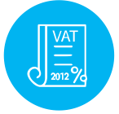
Compatibility
VAT Act 2012

Slide 11
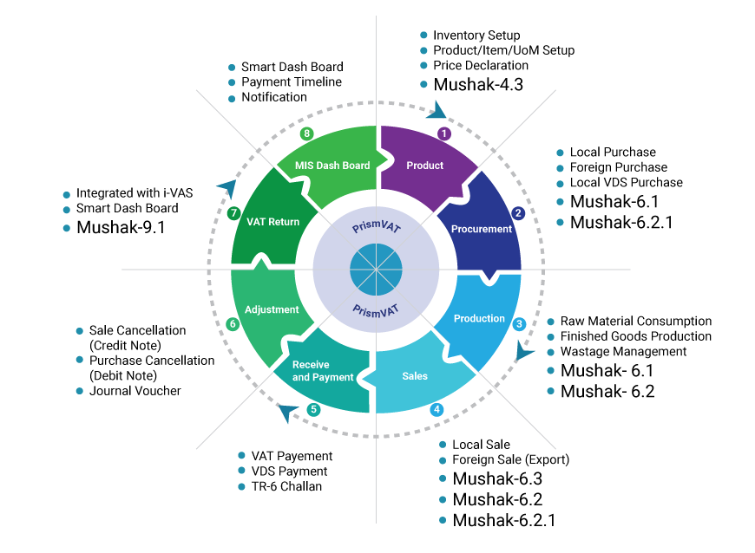
At-a-Glance

Slide 12








Modules
Product
Inventory
Procurement
Sales
Production
VDS
VAT Return
MIS Dashboard

Slide 13
VAT Report 2012
Mushak-4.3: Input-Output Coefficient Declaration
Mushak-6.1: Purchase Register
Mushak-6.2: Sales Register
Mushak-6.2.1: Purchase and Sales Register
Mushak-6.3: VAT Challan Patra
Mushak-6.5: Product Transfer Challan
Mushak-6.10: Purchase and Sale Information for order of more than 2 lacs
Mushak-9.1: Return Submission

Slide 14
Implementation Model
Stand Alone
  User will input directly into the System
Integrate with existing system
  API Available
    Existing System will post data to PrismVAT using PrismAPI
    PrismVAT will fetch data from existing system using custom API
  API Not Available
    API development is feasible
      3rd Party will develop the API
      Divine IT will develop the API
    If not feasible
      User will upload data in PrismVAT using predefined excel file format
      PrismVAT will fetch data from database view

Slide 15
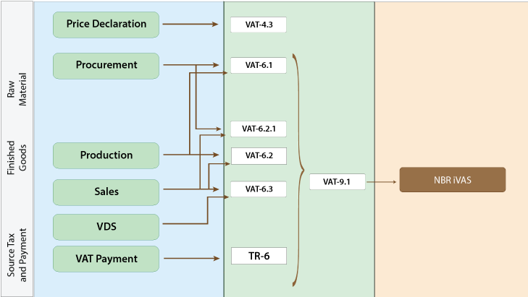
Stand Alone Mode

Slide 16
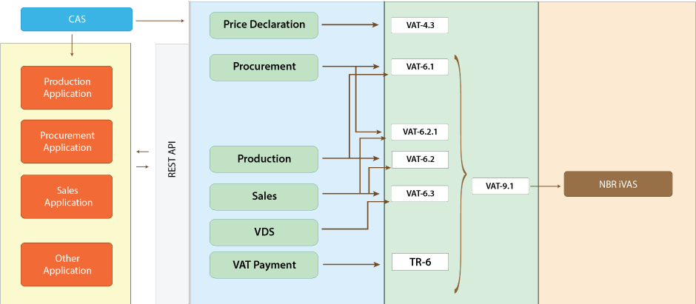
Integrated Mode

Slide 17






Web and Application Security
SQL injection
Protection
Secure web server by configuration
( Yes - Protected)
Encrypted password communication
(Yes - Protected)
Maintaining audit trails
(Yes - Protected)
2FA authentication for application
(Yes)
SSL certificate for all application (Yes - Protected )

Slide 18
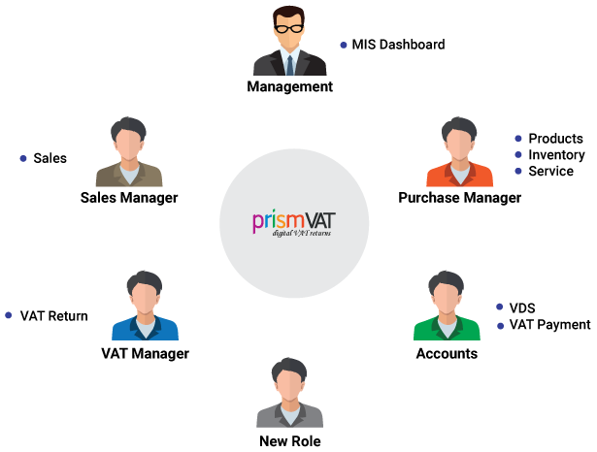
Access Control

Slide 19
Technology
Function | Tools and Technology
Development (Server End) | Python, django, SQLAlchemy
Development (Client End) | HTML5, CSS3, jQuery
API | Restful Service
Client | Chrome, Firefox
Hosting | Linux
Server OS | Apache / Nginx
Database | MySQL
Reporting Tool | BIRT

Slide 20
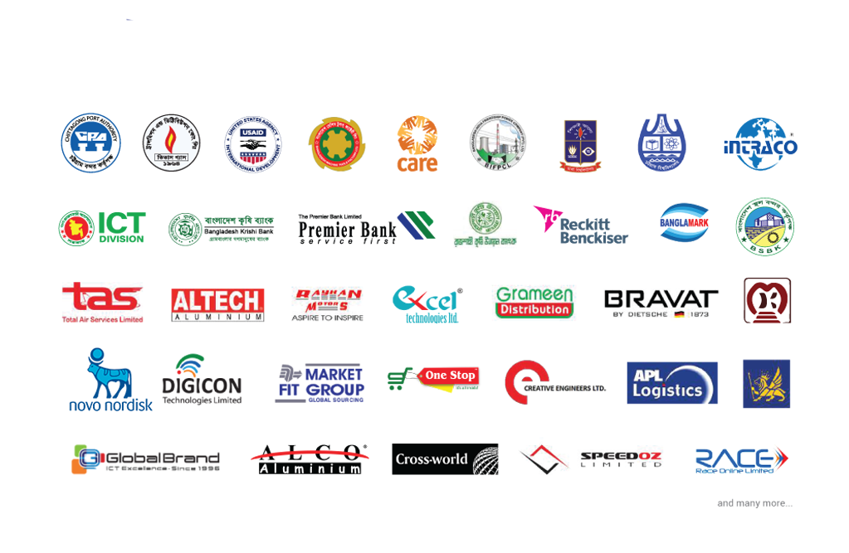
Key Clients

